Slide 1

Sephora Business Profile

Slide 2
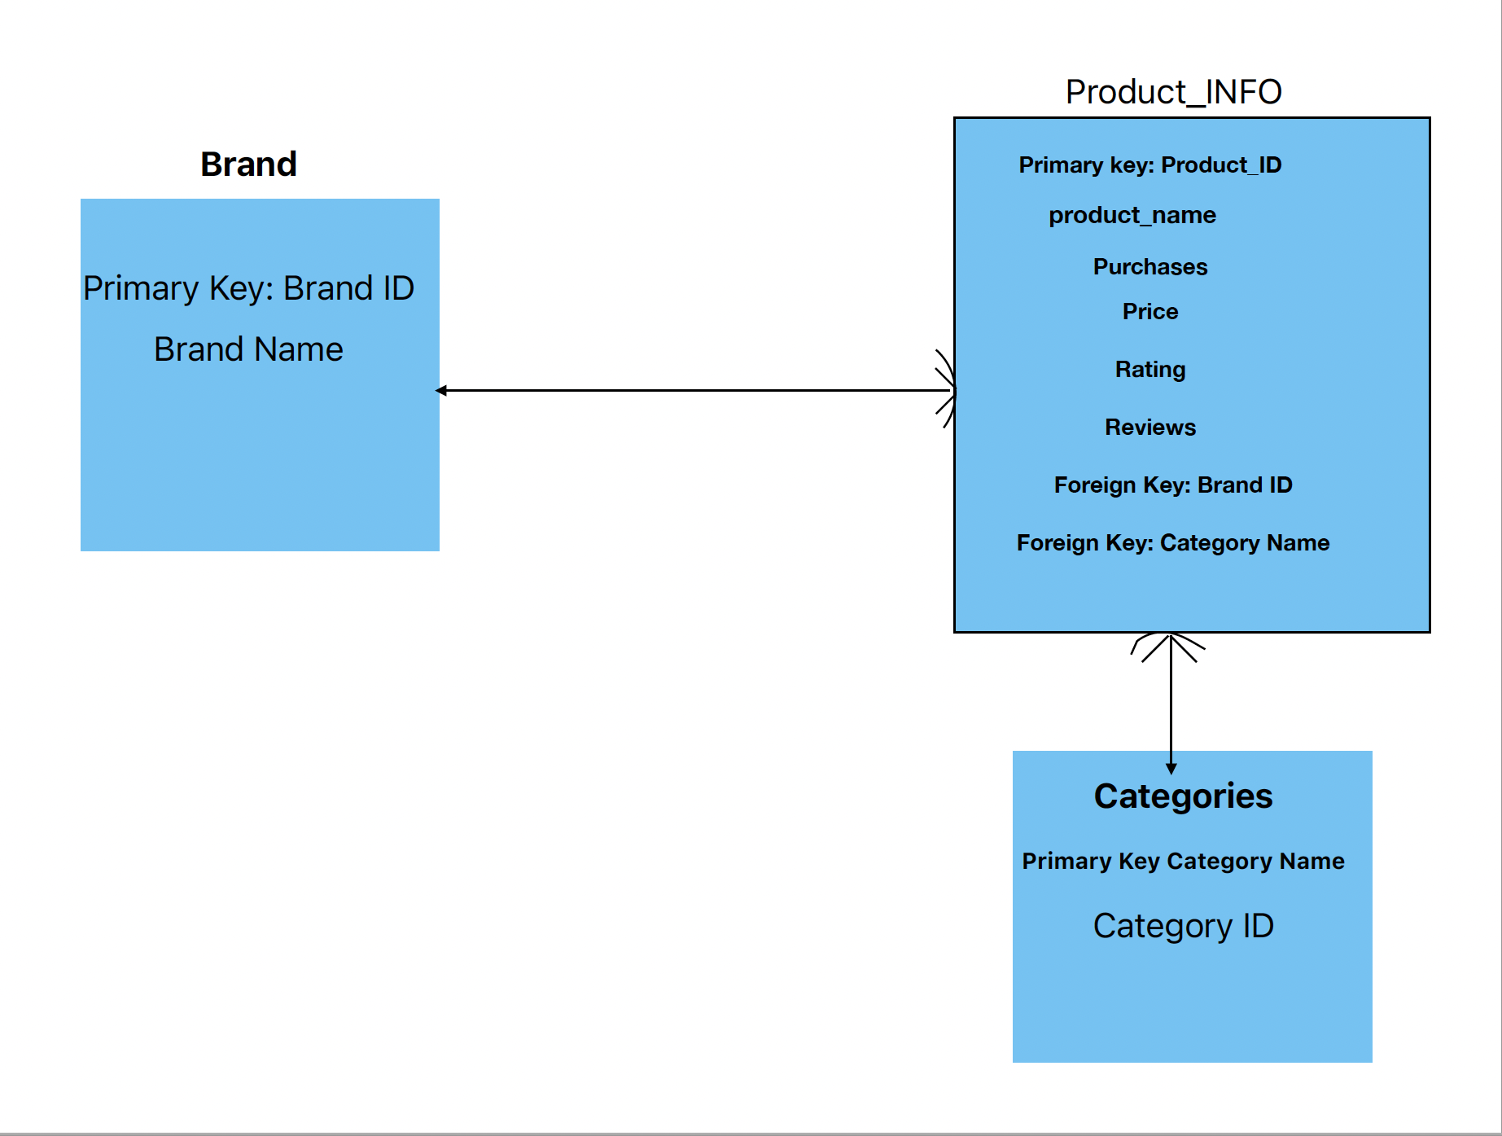

Slide 3

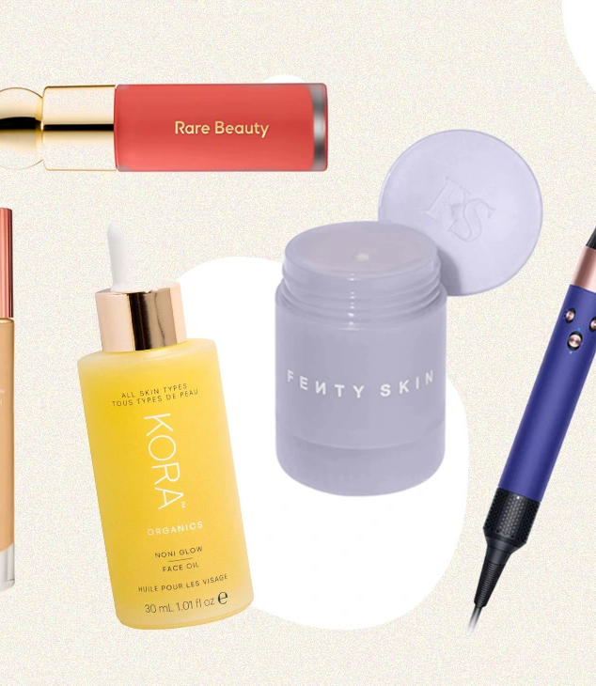
Over View

Slide 4

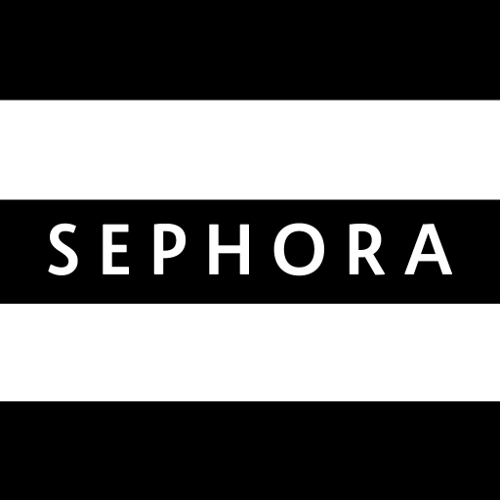
8137 products
304 Brands
Make up
Skincare
Fragrance
Hair
Bath &Body
Mini- size
Men
Tools & Brushes
Sephora Carries

Slide 5
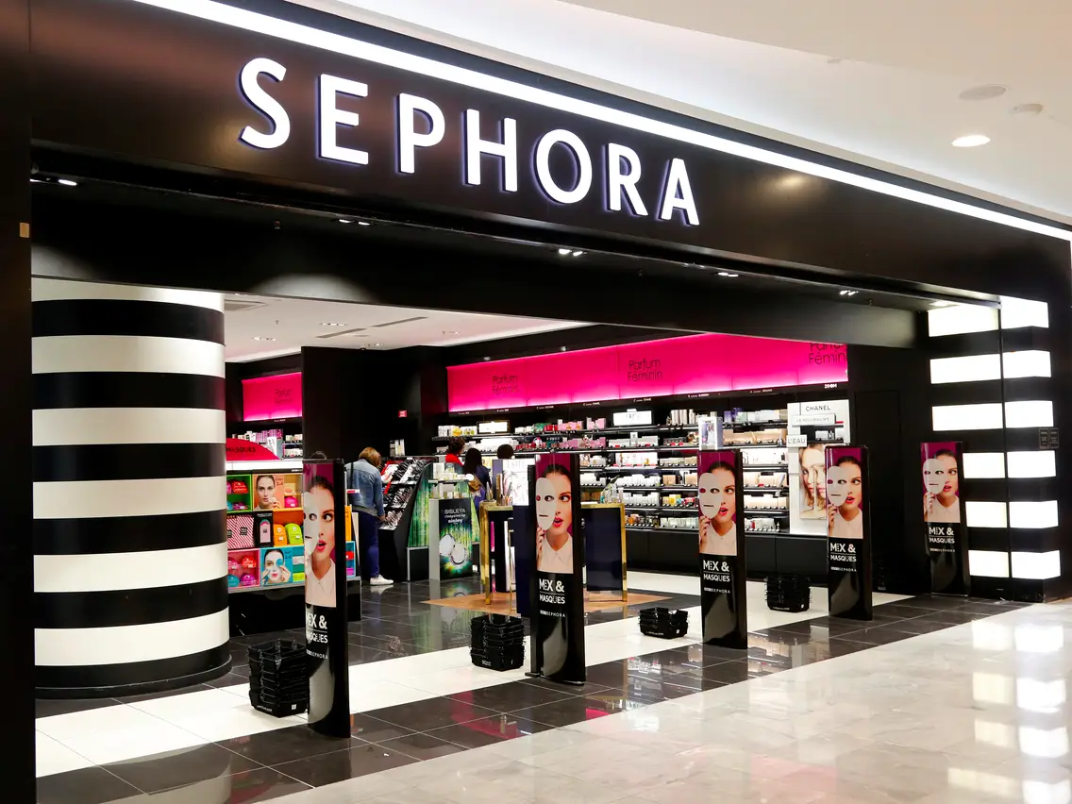
They Sell 239,218,686 Uints
And make a total Sales Revenue of 9,575,320,492 $

Slide 7
category_Name | Average Price
Makeup | 32 $
Skincare | 59 $
Fragrance | 86 $
Hair | 41 $
Bath & Body | 40 $
Mini Size | 21 $
Tools & Brushes | 31 $
Men | 33 $

Slide 8
Top 10 selling products
Product_ID | Product_Name | Purchases | category_Name | Sales
393401 | Luminous Silk Perfect Glow Flawless Oil-Free Foundation | 622995 | Makeup | 42986700
394534 | Black Opium Eau de Parfum | 276396 | Fragrance | 42841400
255506 | Flower bomb | 232390 | Fragrance | 41830200
377873 | Radiant Creamy Concealer | 1153590 | Makeup | 36915000
109908 | Translucent Loose Setting Powder | 813497 | Makeup | 34980400
309308 | Good Genes All-In-One AHA Lactic Acid Treatment | 262434 | Skincare | 32016900
12495 | COCO MADEMOISELLE Eau de Parfum | 257774 | Fragrance | 31448400
378284 | Double Wear Stay-in-Place Foundation | 639063 | Makeup | 30675000
236816 | Dior Addict Lip Glow | 757716 | Makeup | 30308600
Highlights
Top VS Bottom 10 products in sales
across all brands and categories
Bottom 10 selling products
Product_ID | Product_Name | Purchases | category_Name | Sales
78301 | Body-Building Hair Gel | 1361 | Hair | 21776
78300 | Sleek Finish Texture Cream | 1394 | Hair | 22304
122626 | Cream Shave | 1029 | Men | 23667
158509 | Faux Tan Bronzer | 947 | Makeup | 23675
381775 | Bamboo Liquid Hand Soap | 1177 | Bath & Body | 25894
395717 | Clay Pomade | 1219 | Hair | 29256
390708 | Legend Body Spray | 1653 | Bath & Body | 41325
122682 | Aloe Shave Gel | 1811 | Men | 41653
193705 | Verbena Oval Soap | 2789 | Bath & Body | 41835

Slide 9
Highlights
Product_Price | Sales | Product_Name | Brand_Name | category_Name
495 | 376200 | NuFACE Trinity+ & Effective Lip and Eye Attachment | NuFACE | Skincare
465 | 3178740 | DRx SpectraLite BodyWare Pro | Dr Dennis Gross Skincare | Skincare
449 | 7485730 | Trinity + Eye and Lip Enhancer Attachment Bundle | NuFACE | Skincare
449 | 2637880 | Trinity Facial Toning Device + Wrinkle Reducer Attachment Bundle | NuFACE | Skincare
449 | 6377600 | Touch Home Permanent Hair Removal Device | iluminage | Skincare
Most VS Least expensive products
across all brands and categories
Product_Price | Sales | Product_Name | Brand_Name | category_Name
3 | 3582 | Bath Bomb Bath Fizzy | SEPHORA COLLECTION | Bath & Body
3 | 798348 | Cleansing & Exfoliating Wipes | SEPHORA COLLECTION | Skincare
3 | 795 | Mini Cleansing Wipes - Coconut Water | SEPHORA COLLECTION | Skincare
3 | 63243 | Organic Cotton Swabs | SEPHORA COLLECTION | Makeup
3 | 19707 | Mini Clean Cleansing & Gentle Exfoliating Wipes | SEPHORA COLLECTION | Mini Size

Slide 10
Highlights
242 products are rated 5 stars
3 of Which
Are in the Top 10 Selling list
Top VS Bottom Rated products
across all brands and categories
12 Products are rated 1 star

Slide 11
Highlights
TOP 10 Brands in sales
Brand_Name | Sales Share | Num_product
Dior | 332313680.5 | 120
Charlotte Tilbury | 300577243 | 92
TOM FORD | 269211040 | 86
NARS | 242257425 | 60
Fenty Beauty by Rihanna | 241474409 | 74
Tatcha | 219269285 | 48
Drunk Elephant | 217842335 | 56
Anastasia Beverly Hills | 208866305.5 | 91
SEPHORA COLLECTION | 182547734.3 | 342
Urban Decay | 176842194 | 58

Slide 12
In Depth

Slide 13
There are 3 price ranges for sephora products
Under 10 $
Affordable
Up to 50 $
Luxury
Over 50 $

Slide 14
Sales Share per price range Vs Purchased Units share
Price Range | Sales | Purchaces of products
UNDER 10 $ | 77333432.4 | 9769226
Affordable | 5550449996 | 186302898
Luxury | 3947537063 | 43146562
Totals | 9575320491 | 239218686

Slide 15
TOP 10 Brands in sales
Brand_Name | Sales Share | Num_product
Dior | 332313680.5 | 120
Charlotte Tilbury | 300577243 | 92
TOM FORD | 269211040 | 86
NARS | 242257425 | 60
Fenty Beauty by Rihanna | 241474409 | 74
Tatcha | 219269285 | 48
Drunk Elephant | 217842335 | 56
Anastasia Beverly Hills | 208866305.5 | 91
SEPHORA COLLECTION | 182547734.3 | 342
Urban Decay | 176842194 | 58

Slide 16
TOP 10 Brands in sales
Brand_Name | Sales Share | Num_product
Dior | 332313680.5 | 120
Charlotte Tilbury | 300577243 | 92
TOM FORD | 269211040 | 86
NARS | 242257425 | 60
Fenty Beauty by Rihanna | 241474409 | 74
Tatcha | 219269285 | 48
Drunk Elephant | 217842335 | 56
Anastasia Beverly Hills | 208866305.5 | 91
SEPHORA COLLECTION | 182547734.3 | 342
Urban Decay | 176842194 | 58
10 Brands out of 304

Slide 17
TOP 10 Brands in sales
Brand_Name | AVG Price | Price range
Dior | 69.6 | Luxury
Charlotte Tilbury | 41.9 | Affordable
TOM FORD | 155.8 | Luxury
NARS | 31.3 | Affordable
Fenty Beauty by Rihanna | 30.2 | Affordable
Tatcha | 56 | Luxury
Drunk Elephant | 40.2 | Affordable
Anastasia Beverly Hills | 28.1 | Affordable
SEPHORA COLLECTION | 16 | Affordable
Urban Decay | 29.2 | Affordable

Slide 18






TOP 10 Brands in sales
Brand_Name | Sales Share | Num_product
Dior | 332313680.5 | 120
Charlotte Tilbury | 300577243 | 92
TOM FORD | 269211040 | 86
NARS | 242257425 | 60
Fenty Beauty by Rihanna | 241474409 | 74
Tatcha | 219269285 | 48
Drunk Elephant | 217842335 | 56
Anastasia Beverly Hills | 208866305.5 | 91
SEPHORA COLLECTION | 182547734.3 | 342
Urban Decay | 176842194 | 58

Slide 19
Is There a correlation between Prices and Purchases?!!

Slide 20
Is There a Correlation between Purchases and Ratings ?!!

Slide 21
Notes
Sephora has 42 unsold Products Drop.
Sephora’s key strength is in Luxury Products Expand.
Sephora’s major profits come from mid to high price-range product. Sustain.
Sephora’s weakness is in low price-range products. Reconsider.
Ratings don’t reflect any reliable information about products
Buyer beware.

Slide 22
Thank You

